Slide 1

Lecture 8
-NLP is all about words, their arrangement and their meaning
-NLP is a branch of AI that tries to emulate/understand the way a human speaks to another human
-Lecture 8 is about the chatbot ELIZA (Weizenbaum, 1966)

Slide 2
TURING TEST
A test/game
Between two human and a computer
1 human : Interrogator (who asks the questions)
Other human and the computer: participants (who answer the questions)
Interrogator cannot see who is replying (human or computer)
If interrogator unable to distinguish human or computer from the answers provided, Turing test has succeeded
Turing test (Alan Turing, 1950) led to definition of “intelligent machines”

Slide 3
ELIZA – THE CHATBOT
ELIZA, a chatbot (Weizenbaum, 1966)
Mimics the manner in which a psychologist speaks to a patient
Rogerian psychologist (after Carl Rogers the psychologist)
ELIZA passed the TURING test (indistinguishable from a human)
Program of ELIZA based on simple pattern matching
Keywords→ranked
based on top-rank keywords →dismantle the input sentence→ rearrange→add some programmed words
PROBLEM WITH ELIZA: Cannot detect new patterns
“I see” or “Please go on” is ELIZA’s output if unable to detect any keyword
https://en.wikipedia.org/wiki/ELIZA

Slide 4
EXAMPLE of creation of a CHAT
Patient: You are very helpful
ELIZA’s reply?
You→I
Are→am
“very helpful”→very helpful
Add some programmed words: “What makes you think……”
So ELIZA’s reply: What makes you think I am very helpful

Slide 5
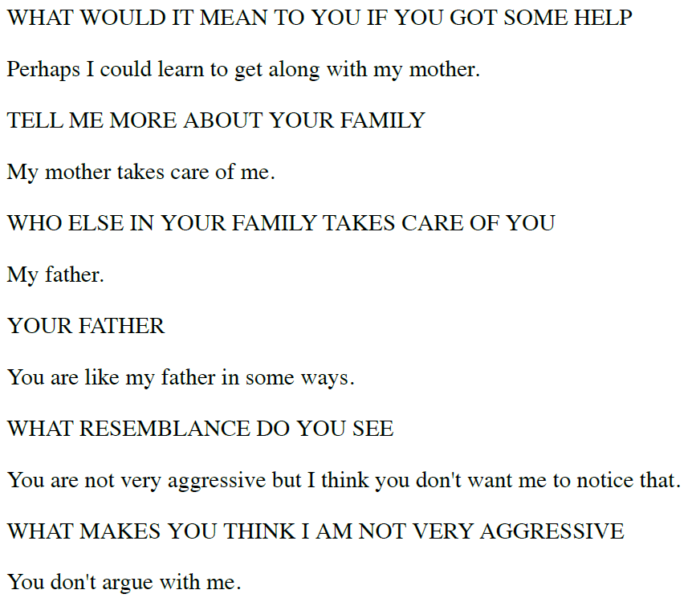
A snapshot of the dialogue between ELIZA and the patient (CAPS: ELIZA)

Slide 6
Answer the Assignment of this week related to ELIZA in the link provided in MOODLE (by Monday 7th Sept’20 11 pm). For this, go through ELIZA’s paper and codes in the internet available in several languages such as JAVA, PYTHON and BASIC

